Slide 1

Omed Hassan

Slide 2

Lecture details
What is research
Why research is done
Steps involved in carrying out a research

Slide 3
What is research
Research can be defined as:
Search for knowledge.
Any systematic investigation, with an open mind, to establish novel facts, solve new or existing problems, prove new ideas, or develop new theories.

Slide 4
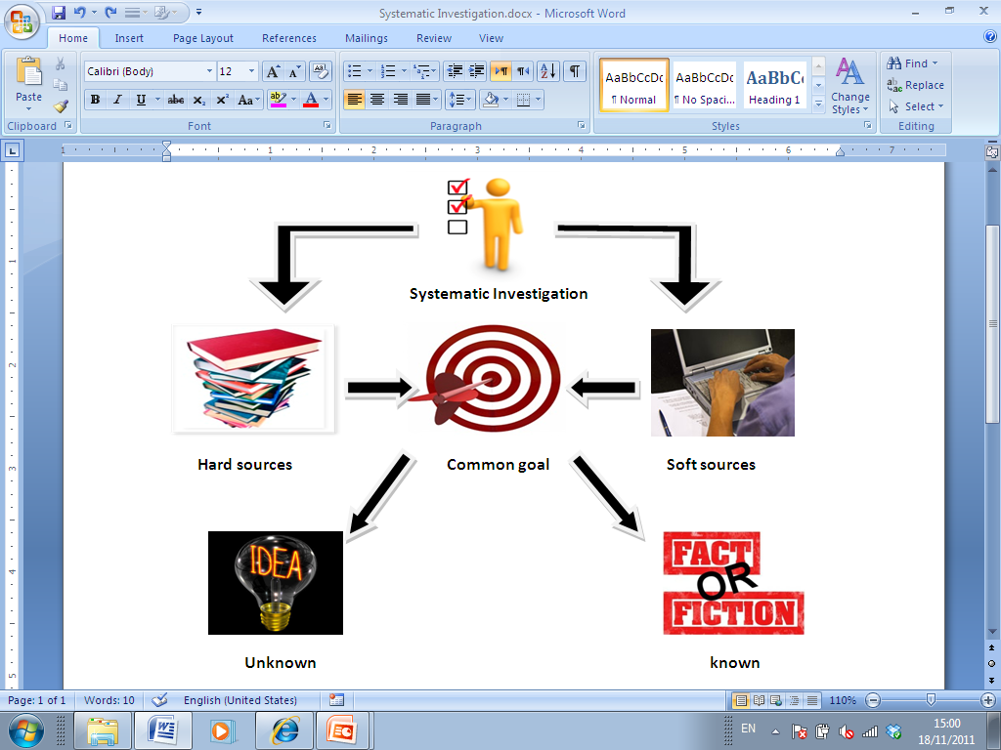
What is research

Slide 5



Why research is done
When we have questions
When we need information
When we have a problem

Slide 6
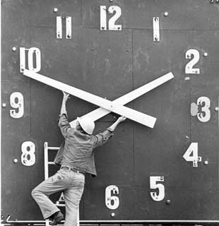
Set research time
How much time can you devote to it?
- In what increments?
- Over what period?
If you don’t set a time frame for research and writing, you will read and write endlessly

Slide 7
Research Process
A research process consists of series of actions or steps necessary to effectively carry out research and the desired sequencing of these steps.
To produce new knowledge, or to offer a new manner of understanding present knowledge.

Slide 8
Research Processes
Choosing a topic
Report and evaluate research
Identify the research problem
Analyse and interpret data
Literature review
Collect data
Type and amount of information

Slide 9
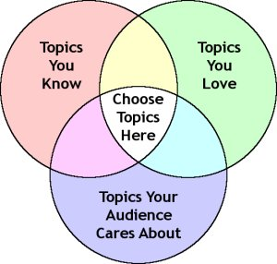
Stage 1: Choosing a topic
There are three possibilities
1- Topic is given to you with a title
2- Topic is given to you with out a title
3- Topic and title are unknown / new research

Slide 10

Stage 2: Identify the problem research
A research problem is an issue or concern that an investigator presents and justifies in a research study.
25/02/2015
Human Development University Computer Science Department
25/02/2015
Human Development University Computer Science Department
10

Slide 11
Stage 2: Identify the problem research
A problem that someone would like to research
Anything that a person find unsatisfactory or unsettling, a difficulty of some sort, a state of affairs that need to be changed.
A problems involve areas of concerns to researchers, for condition they want to improve, difficulties they want to eliminate, questions for which they want to seek answers.
25/02/2015
Human Development University Computer Science Department
11

Slide 12
Stage 3: Literature Review
What is literature review?
As a name applies it is a review of all literature done so far on your topic.
It is usually written as separate chapter.
Functions of a literature review
There are 4 thing sets out to do:
Focus on previous research.
Shown how your study fills the “gap”
The necessity for your study.
Sets boundaries(Limitation of the studies).

Slide 13
Stage 3: Literature Review
Scope and length
A void verbosity
literate.
Brief but focus.
It should be include:
A summery of existing knowledge Critical Evaluation
25/02/2015
Human Development University Computer Science Department

Slide 14
Stage 3: Literature Review
Basically the literature review sees to answer the following questions:
What has been done before?
What have others said?
What is the relevance?
What is deference?
Agreement /Disagreement?
Are there flows?
25/02/2015
Human Development University Computer Science Department
25/02/2015
Human Development University Computer Science Department
14

Slide 15

Stage 3: Type and amount of information
How much historical background we need?
How up to date must information be?
Do we need to collect from multiple sources?
How much data do you need?

Slide 16

Stage 4: Collect Data

Slide 17
Stage 5: Analyse and interpret data
Why do I need an analysis plan?
To make sure the questions and your data collection instrument will get the information you want.
To align your desired “report” with the results of analysis and interpretation.
To improve reliability--consistent measures over time.
Quantitative Data
Is presented in a numerical format collected in a standardized manner e.g. surveys, closed-ended interviews, tests.
Qualitative data
we gather in extension are more generalizable than quantitative data.

Slide 18
Stage6:Report and evaluate research
Report research
Determine the audience for the report
Structure the report
Write the report sensitively and accurately
Evaluate research
Assess the quality of research using recognized stands in a discipline
Standards can come from the academic community, school districts, or federal or state agencies.

Slide 19
Useful references
http://www.ipl.org/div/aplus/step1.htm
http://www.networkedcranfield.com/cell/Assigment%20Submissions/research%20philosophy%20-%20issue%201%20-%20final.pdf
http://repository.wit.ie/1466/1/Choosing_the_Appropriate_Methodology_Understanding_Research_Philosophy_(RIKON_Group).pdf
http://www.is.cityu.edu.hk/staff/isrobert/phd/ch3.pdf

Slide 20
End
Thank you
??????

